Slide 1
Git & Github

Slide 2
Module Contents:
Module 1: Why Git? Real-World Problems without it
Module 2: Git Basics & The 3-Staged Workflow
Module 3: From Local to GitHub
Module 4: Branching, Merging and Conflict Resolution
Module 5: GitHub for Team Collaboration
Module 6: Undo, Reset, Restore & Revert
Module 7: GitHub Actions & Modern Automation
Module 8: Git in Job Interviews & Open Source

Slide 3
Module 1 Content:
What is Git?
Git Definition
Features of Git
What is GitHub
Real-life vs Git/GitHub
Installations

Slide 4
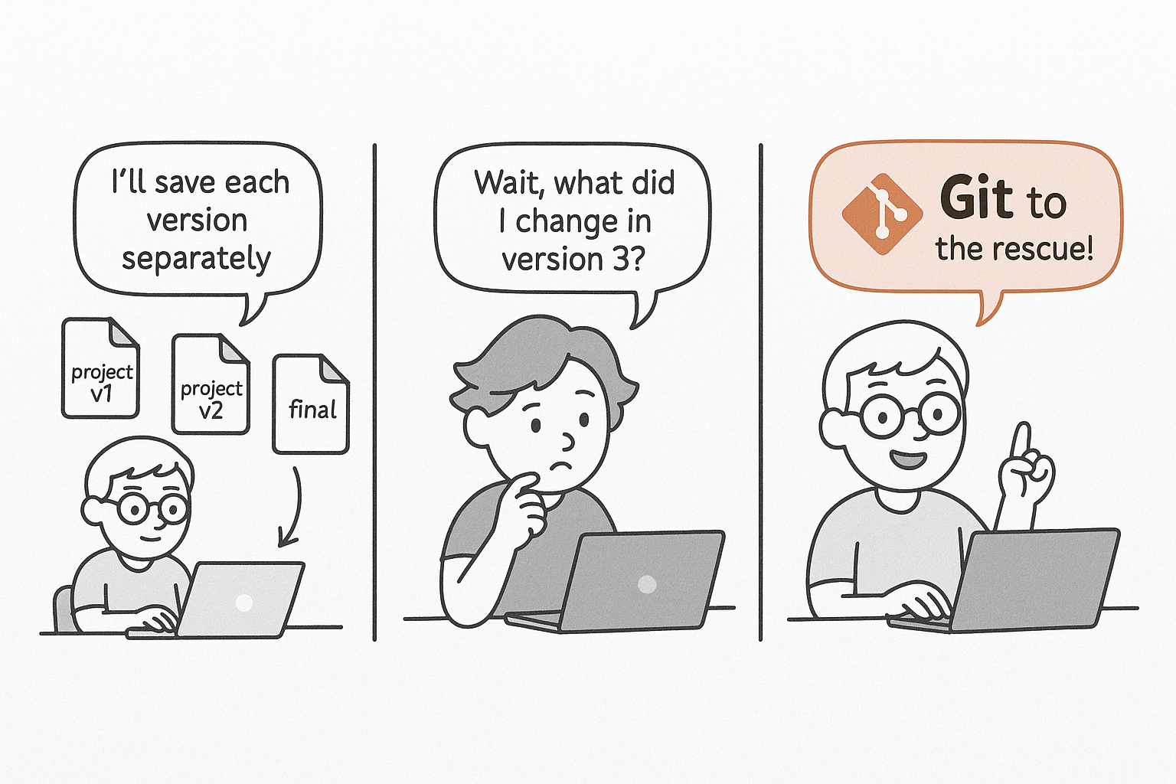
What is GIT ?

Slide 5
Git Definition:
Git is like a smart notebook that remembers every change you make to your project – whether it’s a document, a coding file or a design.
It’s a tool that helps you track changes, go back in time, and work with others on a project without losing changes.
It’s a Version Control System tool.

Slide 6
Git is like a Time Machine
Notes:
Think of Git as your automatic time machine and team manager. It remembers every change, who made it, and lets you jump back in time — without all those messy filenames.”

Slide 7
Features of Git
Popular
Free and Open Source
Version Tracking (commits)
Branching and Merging
Collaboration
Change history (Log)
Can work offline
Undo history

Slide 8

What is GitHub?
GitHub allows you to store your project online and collaborate with others.
It lets you:
See the history of changes
Comment on each other’s work
Suggest improvements (pull requests)
And work together from anywhere
Notes:
Git helps you track your own project changes on your computer. But when you want to show your project to the world or work with others, you upload it to GitHub. It’s like turning your private notebook into a public or shared notebook in the cloud

Slide 9
Real-life Vs Git & Github
Real-life Paper Writing Git/Github Equivalent
Saving the document git commit
Creating copies like V1, V2 git versions(commits)
Using “Track Changes” git shows line-by-line differences
Undoing a bad change git revert or git checkout
Collaborating via Google Docs GitHub allows real- time team work
Adding suggestions in comments GitHub Pull Requests & Code Reviews

Slide 10
Installation
Git : https://git-scm.com/downloads
Check Git version: git --version
Create GitHub account: https://github.com
Configure Git
Set up Name, email:
git config --global user.name "Your Full Name“
git config --global user.email your_email@example.com
Check your git configuration
Git config --list
Create GitHub Profile

